Slide 1
Risk Analysis – Banking, Financial Services and Insurance

Slide 2
Agenda
Introduction
Data Overview
Data Cleaning and Pre – processing steps
Exploratory Data Analysis on Application Data Table
Exploratory Data Analysis on Previous Application Data Table
Dashboards from PowerBI
Predictive Modelling
Image source: icons8`

Slide 3
Introduction
Business Objective :
The case study aims to identify patterns which indicate if a client has difficulty paying their installments which may be used for taking actions such as denying the loan, reducing the amount of loan, lending (to risky applicants) at a higher interest rate, etc. This will ensure that the consumers capable of repaying the loan are not rejected. Identification of such applicants using EDA is the aim of this case study.
In other words, the company wants to understand the driving factors (or driver variables) behind loan default, i.e. the variables which are strong indicators of default. The company can utilize this knowledge for its portfolio and risk assessment.
Image source: icons8`

Slide 4
Data Overview
2 Tables :
Application Table
Columns | 122
Entries / rows | 3,07,511
Primary Key | SK_ID_CURR
Contains information of all the current loan applications, including loan id, contract type, credit amount, gender of the applicant, income level, education level, family status, regional population, contact information, real estate ownership information, different documents submitted etc, along with the TARGET (indicator if the applicant can be a potential defaulter)
Previous Application Table
Columns | 37
Entries / rows | 16,70,214
Primary Key | SK_ID_PREV
Contains information of all the previous home loan applications, including loan id, contract type, credit amount, status of previous loan, Relative to current application when was the decision about previous application made, Payment method that client chose to pay for the previous application, portfolio type, yield type etc
Image source: icons8`

Slide 5
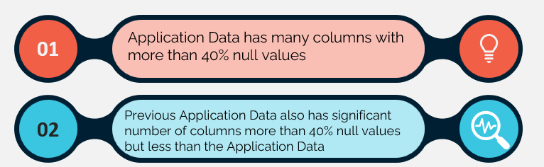
Observations made during Data Auditing:
Image source: icons8`

Slide 6
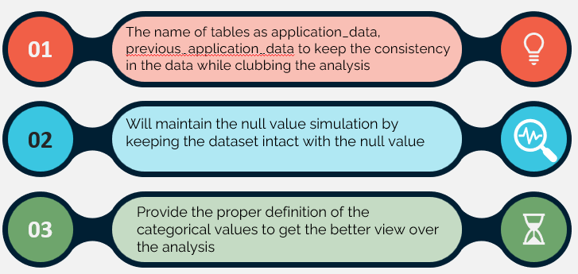
Data Cleaning and Pre-processing
Image source: icons8`

Slide 7



Exploratory Data Analysis
Understanding The Demographics
Minimum Income : INR 25K
Max Income : INR 11.7Cr
Average Income : INR 1.68L
Male Vs Female Ratio : 1.93
Age distribution
Minimum age : 20
Maximum age: 70
35- 40 years has max applicants
Image source: icons8`

Slide 8
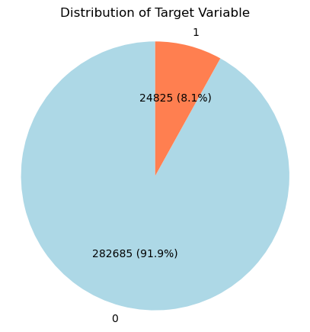
Exploratory Data Analysis
Distribution Of Target Variable
Insight :
The majority of the individuals in the dataset are non-defaulters, making up approximately 91.9% (282,686 out of 307,511) of the total sample
Defaulters are only about 8.1% of the sample
The relatively low percentage of defaulters suggests that most individuals are managing their loans well.
Image source: icons8`

Slide 9
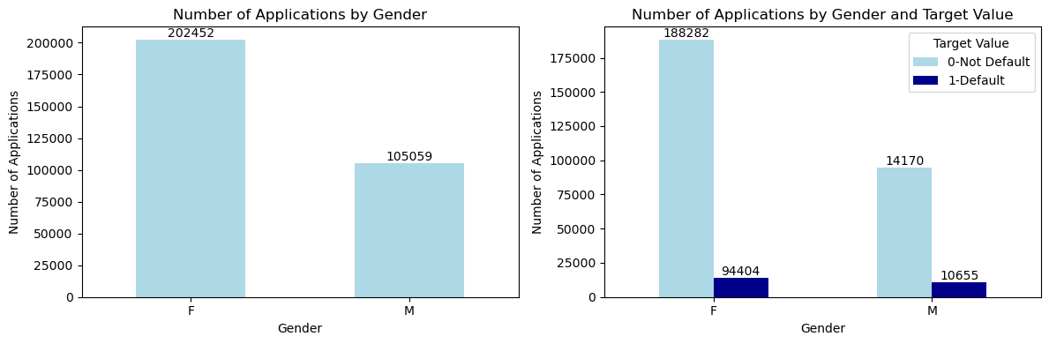
Exploratory Data Analysis
Analyzing The Gender Ratio
Insight :
Females account for a larger share of applications (65.8%) compared to males (34.2%).
This suggests that female applicants are more prevalent in the dataset.
Image source: icons8`

Slide 10
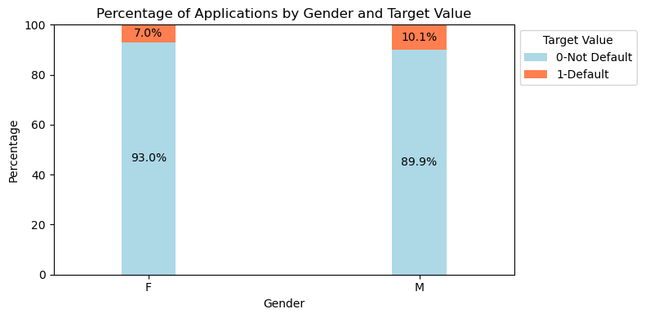
Exploratory Data Analysis
Insight :
Application Share:
Females make up 65.8% of applications.
Males account for 34.2% of applications.
Non-Default Rates:
93.0% of female applicants are non-defaulters (188,282 out of 202,452).
89.9% of male applicants are non-defaulters (94,404 out of 105,059).
Default Rates:
Female default rate is 7.0% (14,170 out of 202,452).
Male default rate is 10.1% (10,655 out of 105,059).
Male applicants show a higher likelihood of default compared to female applicants.
Analyzing The Gender Ratio
Image source: icons8`

Slide 11
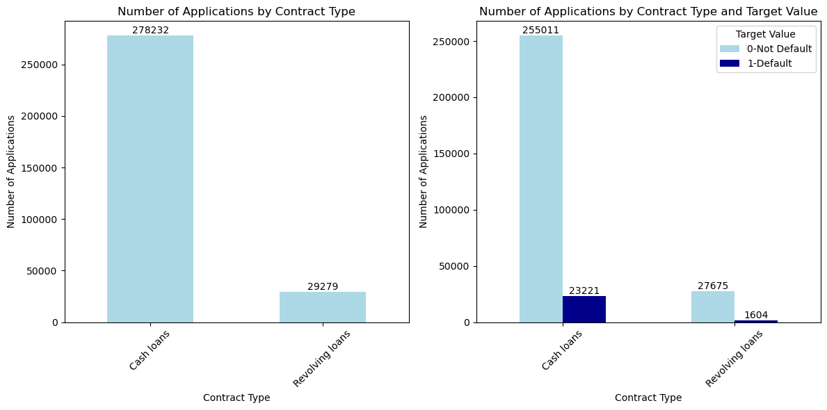
Exploratory Data Analysis
Analyzing The Contract Type
Insight :
Cash loans are the dominant type of loan, making up approximately 90.5% of total applications.
Revolving loans constitute around 9.5%.
Image source: icons8`

Slide 12
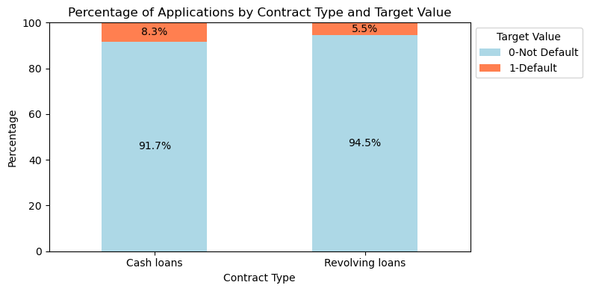
Exploratory Data Analysis
Analyzing The Contract Type
Insight :
Loan Distribution:
Cash loans make up 90.5% of total applications.
Revolving loans constitute 9.5% of total applications.
Default Rates by Contract Type:
Cash loans have a default rate of 8.3% (23,221 out of 278,232).
Revolving loans have a lower default rate of 5.5% (1,604 out of 29,279).
Non-Default Rates by Contract Type:
Cash loans have a non-default rate of 91.7% (255,011 out of 278,232).
Revolving loans have a higher non-default rate of 94.5% (27,675 out of 29,279).
Image source: icons8`

Slide 13
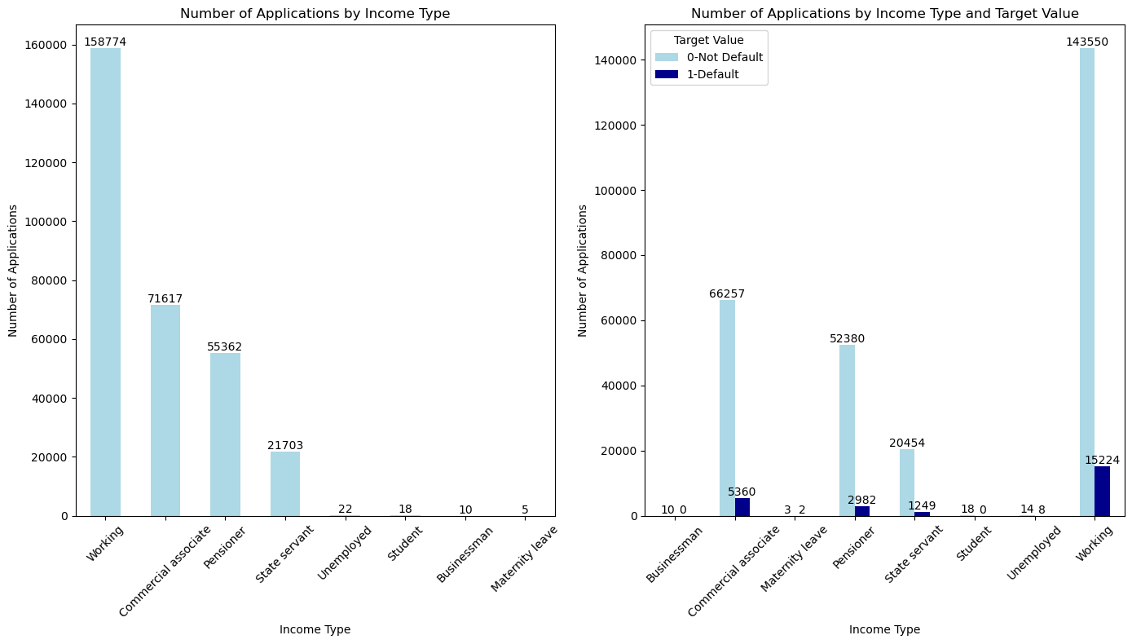
Exploratory Data Analysis
Let's Look At The Income Type
Insight :
The majority of applications come from individuals classified as "Working" (approximately 50.5%), followed by "Commercial Associate" (about 23.5%), and "Pensioner" (around 18%). Other categories contribute very few applications.
Image source: icons8`

Slide 14
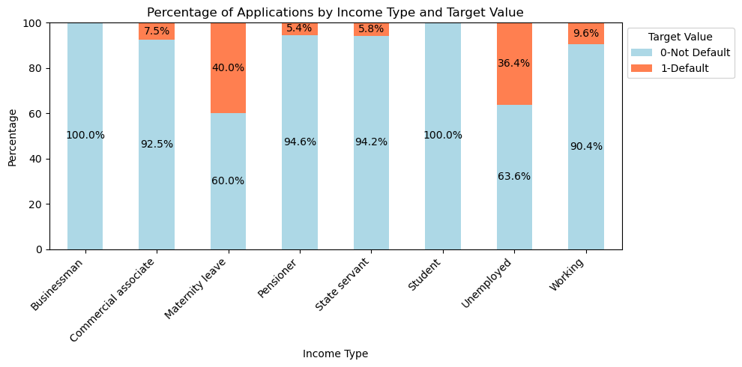
Exploratory Data Analysis
Let's look at the income type
Insight : Most applications are from "Working" individuals (50.5%), followed by "Commercial Associate" (23.5%) and "Pensioner" (18%). The highest default rates are for "Unemployed" (36.4%) and "Maternity Leave" (40%). "Working" applicants have a 9.6% default rate, indicating stable employment leads to better repayment.​
Image source: icons8`

Slide 15
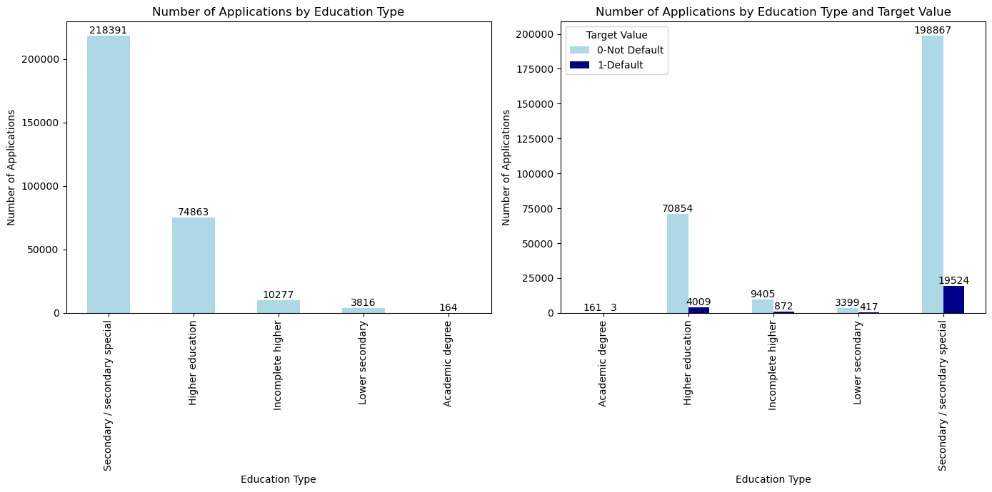
Exploratory Data Analysis
Analyzing the Education Type
Insight:
Most applications come from individuals with Secondary/ Secondary Special education (218,391),
followed by Higher Education (74,863). Those with an Academic Degree have a low default rate (3 out of 161).
Image source: icons8`

Slide 16
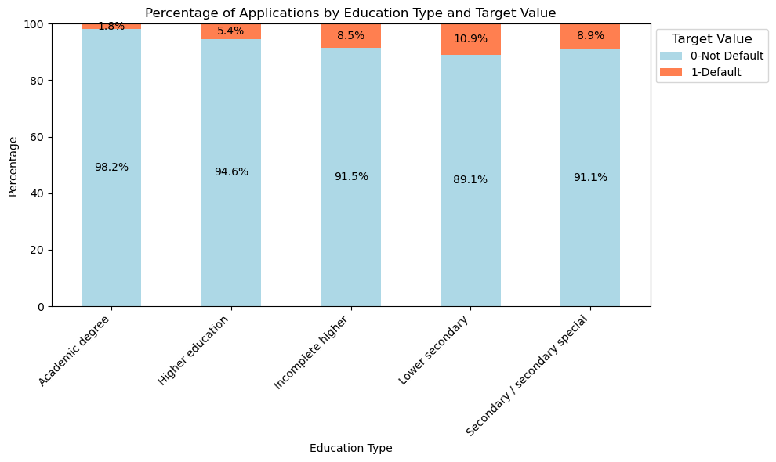
Exploratory Data Analysis
Analyzing the Education Type
Insight:
The Secondary group has 198,867 non-defaulters and 19,524 defaulters (8.9%),
Lower Secondary education shows higher risk with 3,399 non-defaulters and 417 defaulters (11.0%).
Image source: icons8`

Slide 17
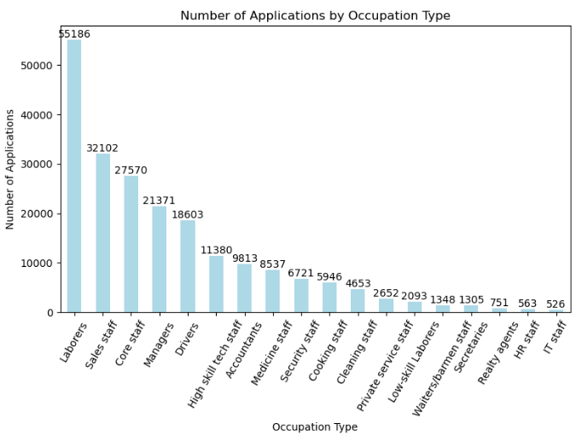
Exploratory Data Analysis
Analyzing the Occupation Type
Insight :
Laborers: Largest group, ~22.4% of total applications
Other Significant Segments: Sales Staff and Core Staff Indicates strong interest among lower and middle-skilled workers
Managers: Notable application numbers
High-Skill Roles (e.g., IT Staff, HR Staff): Less represented, possibly due to more stable financial situations
Image source: icons8`

Slide 18
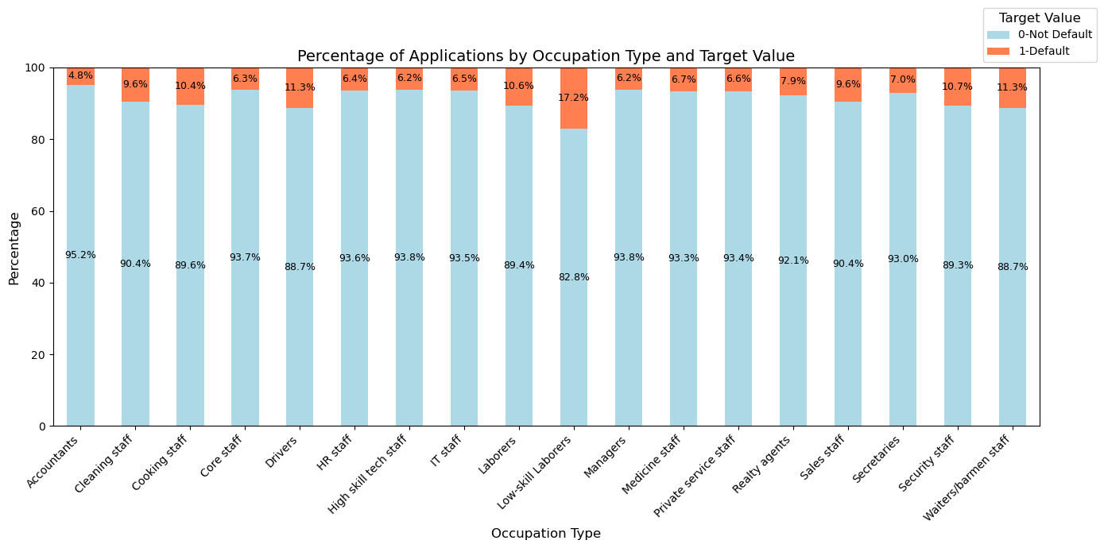
Exploratory Data Analysis
Analyzing the Occupation Type
Insight : Laborers make up 22.4% of loan applications, with the highest defaults (5,838) and a 10.6% default rate. Sales Staff (9.6%) and Drivers (11.3%) also show instability. Core Staff (6.3%) and High Skill Tech Staff (6.2%) have moderate rates, while Accountants have the lowest at 4.8%, indicating better financial stability.
Image source: icons8`

Slide 19
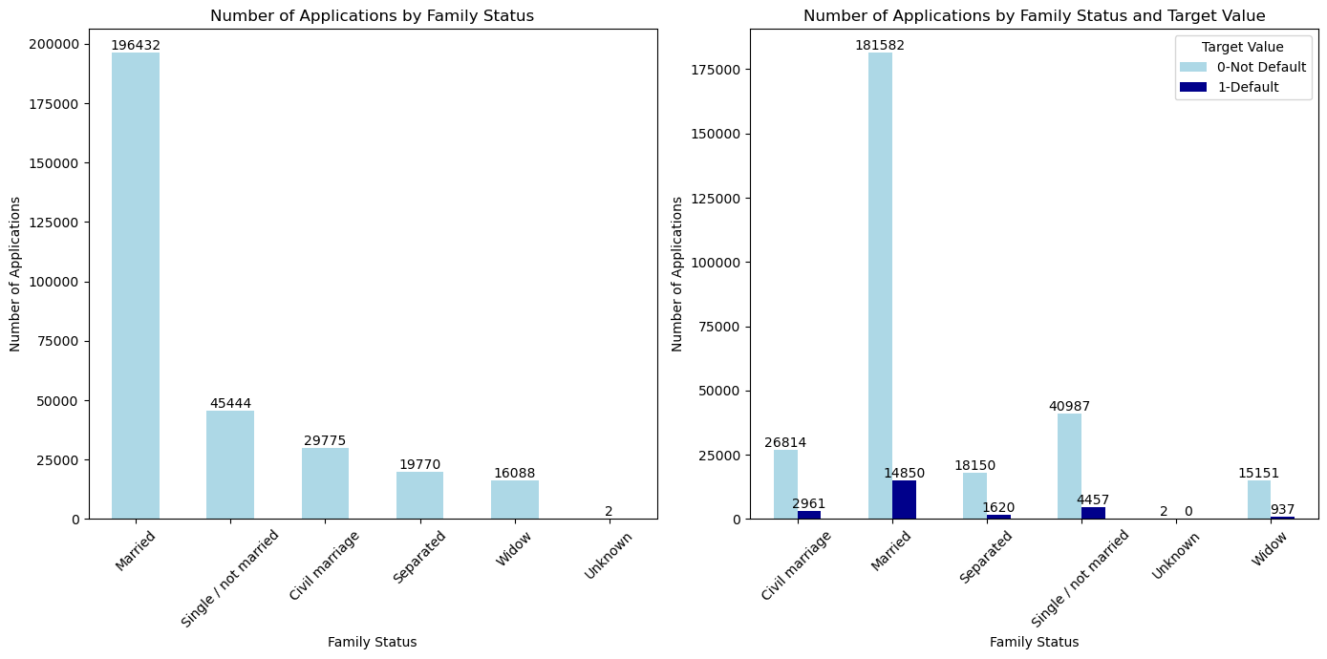
Exploratory Data Analysis
Analyzing the Family Status
Insight :
Married individuals account for the largest share of applications (196,432), representing about 62.5% of total applications.
Image source: icons8`

Slide 20
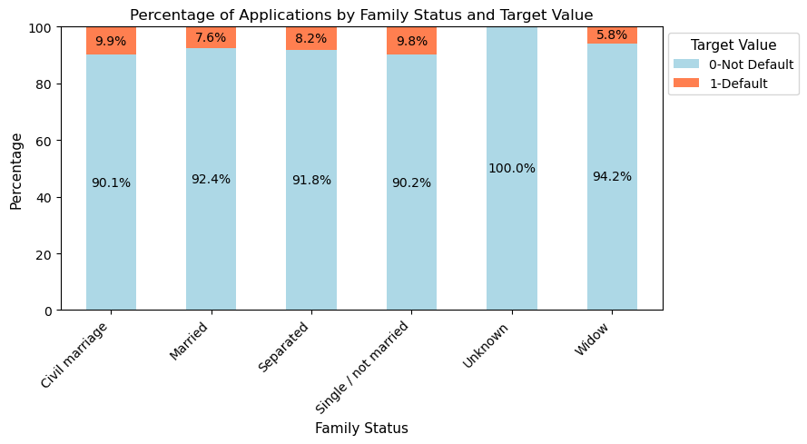
Exploratory Data Analysis
Analyzing the Family Status
Insight:
Married individuals make up 62.5% of applications (196,432).
Civil Marriage default rate is 9.9%, and Separated individuals have an 8.2% rate.
Widows have a lower default rate of 5.8% (16,088 applications).
Single/Not Married applicants (45,444) have a higher default rate of 9.0%.
Married applicants show a low default rate of 7.6%.
Image source: icons8`

Slide 21
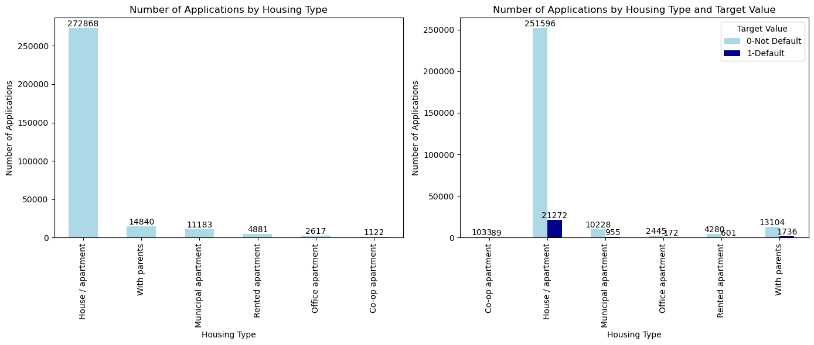
Exploratory Data Analysis
Analyzing the Housing Type
Insight :
The data shows that 70% (272,868) of loan applications come from individuals in stable housing, indicating a strong link between housing stability and loan-seeking behavior. Rented apartments account for 4,881 applications (1.3%), office apartments for 2,617 (0.7%), and co-op apartments for 1,122 (0.3%), highlighting their limited presence among applicants.
Image source: icons8`

Slide 22
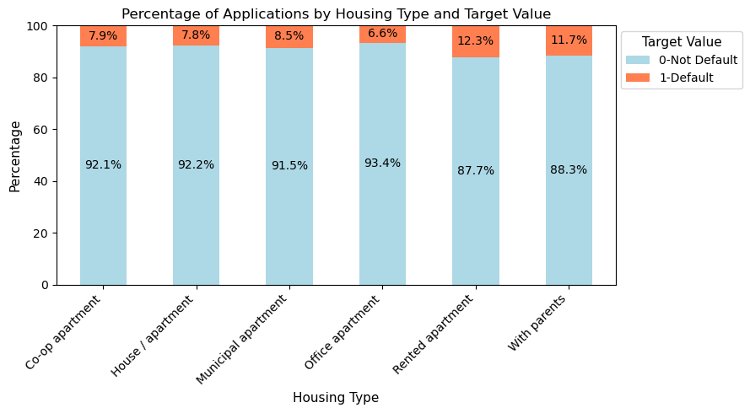
Exploratory Data Analysis
Insight:
Majority of Applications: 272,868 (about 70%) from stable housing.
Rented Apartments: 4,881 applications (1.3%).
Office Apartments: 2,617 applications (0.7%).
Co-op Apartments: 1,122 applications (0.3%).
Default Rates: House/apartment applicants at 7.8%, while living with parents is 11.7%.
Renters: Highest default rate at 12.3% (601 defaulters).
Analyzing the Housing Type
Image source: icons8`

Slide 23
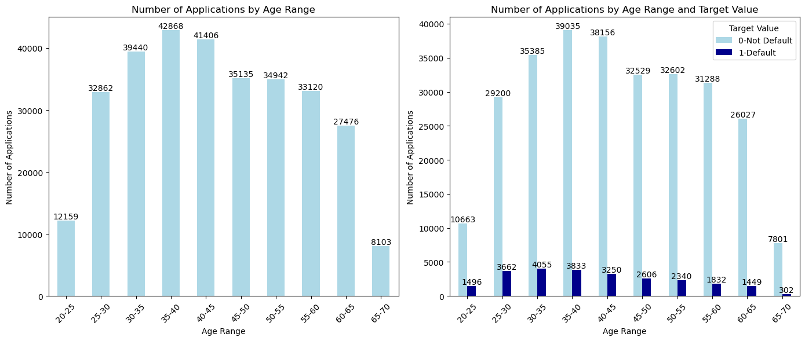
Exploratory Data Analysis
Analyzing the Age Range
Insight :
The 35-40 age group leads with 42,868 applications, about 16.2% of the total, The 30-35 age group follows closely with 39,440 applications (15.0%), indicating financial activity related to career and family investments.
The 25-30 age group has 32,862 applications, making up around 12.4% of total applications.
Image source: icons8`

Slide 24
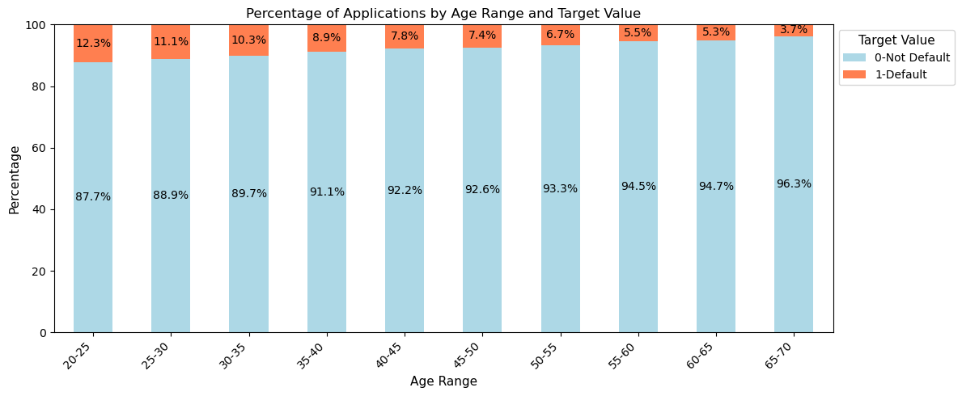
Exploratory Data Analysis
Analyzing the Age Range
Insight :
The 35-40 age group has the most applications at 42,868 (16.2%), followed by 30-35 with 39,440 (15.0%), and 25-30 with 32,862 (12.4%).
The 20-25 age group shows the highest default rate at 12.3%, indicating repayment challenges.
Default rates decrease with age, falling to 3.7% for the 65-70 age group, suggesting greater financial stability among older borrowers.
Image source: icons8`

Slide 25
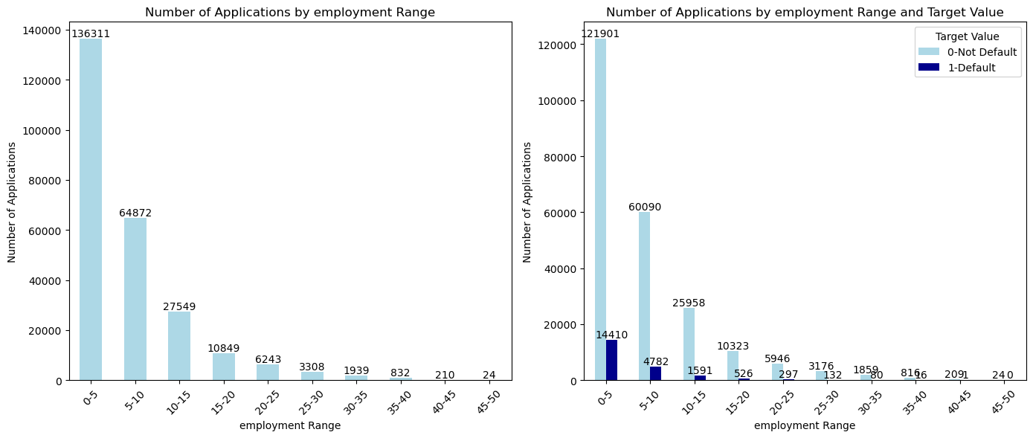
Exploratory Data Analysis
Analyzing the Employment Range
Insight:
Most applications are from individuals with **0-5 years** (136,311) and **5-10 years** of experience (64,872).
Higher default rates are seen in less experienced borrowers.
Default rates drop with experience; **10-15 years** has **5.9%** and **45-50 years** has no defaults.
Less experience is linked to higher default risk, while more experience indicates stability.
Image source: icons8`

Slide 26
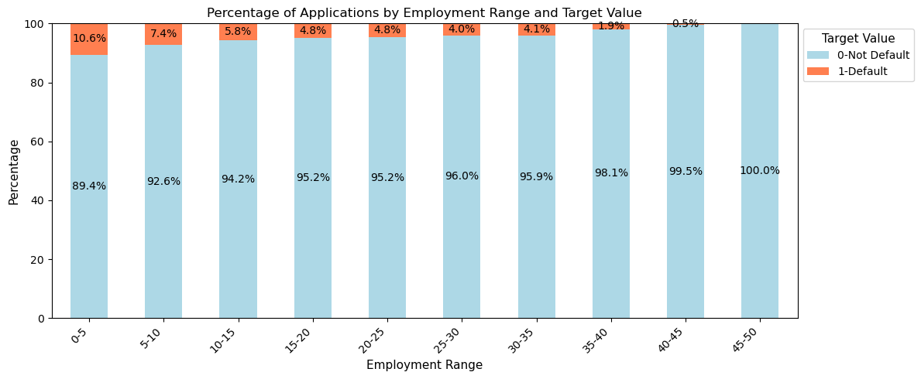
Exploratory Data Analysis
Analyzing the Employment Range
Most applications (136,311) are from individuals with 0-5 years of experience, followed by 64,872 from those with 5-10 years. Default rates are higher among less experienced applicants, decreasing significantly with more experience. For example, the 10-15 years group has a 5.9% default rate, while the 45-50 years group has none. This suggests that limited employment experience is linked to higher default risk, whereas longer employment histories indicate greater stability.
Image source: icons8`

Slide 27
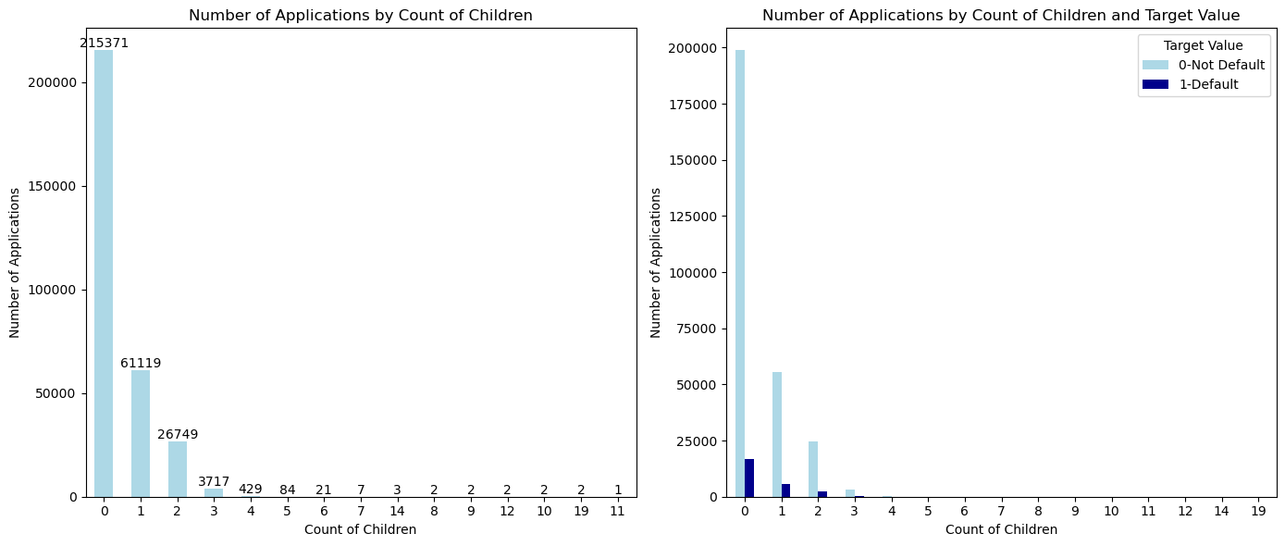
Exploratory Data Analysis
Analysis on number of children
The majority of applicants (215,371) have no children, with numbers decreasing sharply as the count of children increases.
Notably, as the number of children increases, the proportion of defaults relative to total applications also rises, pointing to a potential correlation between family size and financial risk.
Image source: icons8`

Slide 28
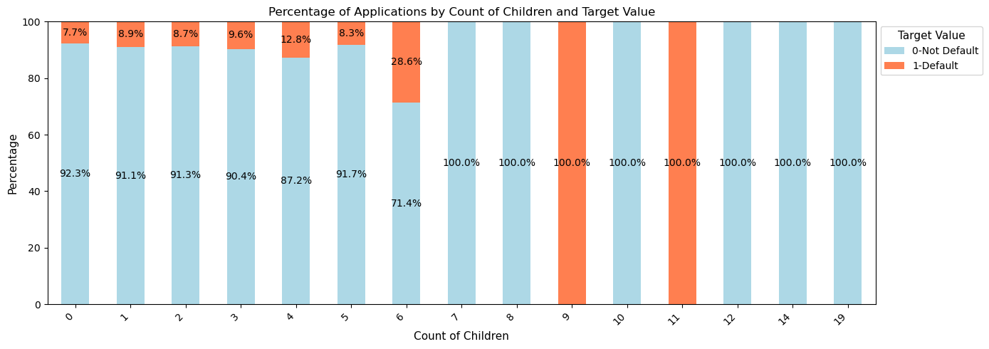
Exploratory Data Analysis
Analysis on number of children
Insight:
When examining defaults, families with no children have 198,762(92.3%) non-defaults compared to 16,609(7.7%) defaults, indicating a strong likelihood of stability among childless applicants.
Image source: icons8`

Slide 29
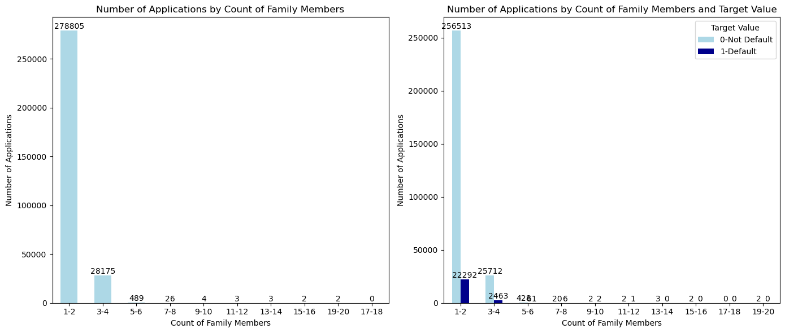
Exploratory Data Analysis
Analysis on count of family members
Insight:
The majority of applications (278,805) come from families in the 1-2 member range, highlighting a preference for smaller households.
Applications drop sharply as family size increases, with only 28,175 from families with 3-4 members and even fewer from larger families.
Image source: icons8`

Slide 30
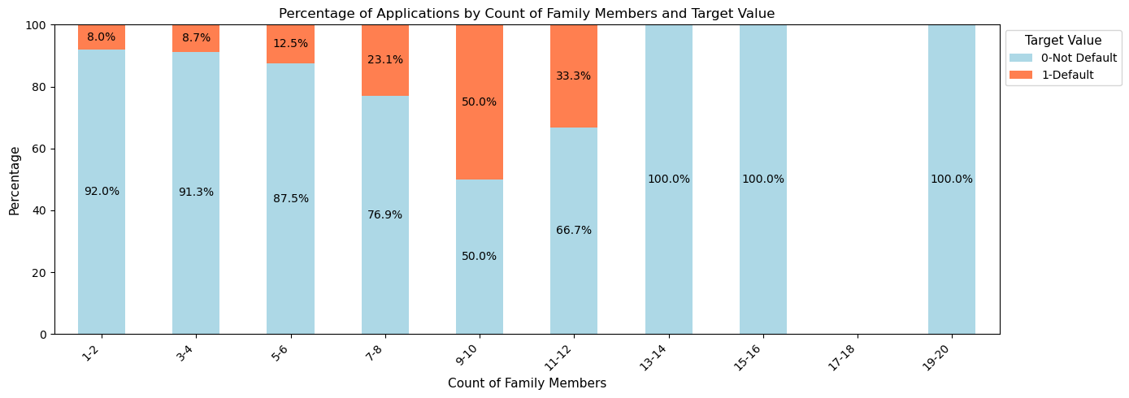
Exploratory Data Analysis
Analysis on count of family members
Insight:
Non-default rates are significantly higher among smaller families, with 256,513(92%) non-defaults and 22,292(8%) defaults in the 1-2 member category.
Larger families exhibit increased financial risk, as evidenced by lower application counts and minimal default data.
Image source: icons8`

Slide 31
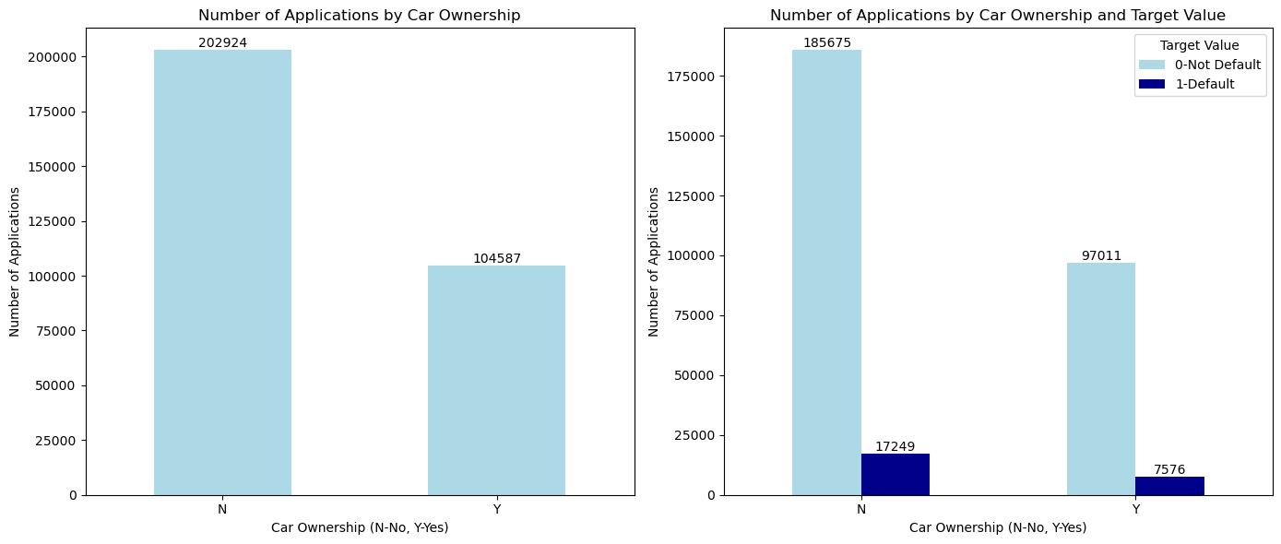
Exploratory Data Analysis
Analyzing the Car Ownership
Insight :
The "No Car" group comprises 202,924 applications, representing about 66% of the total. In contrast, the "Own Car" group has 104,587 applications, accounting for around 34% of the total.
Car ownership suggests greater financial stability and the capacity to invest in assets.
Image source: icons8`

Slide 32
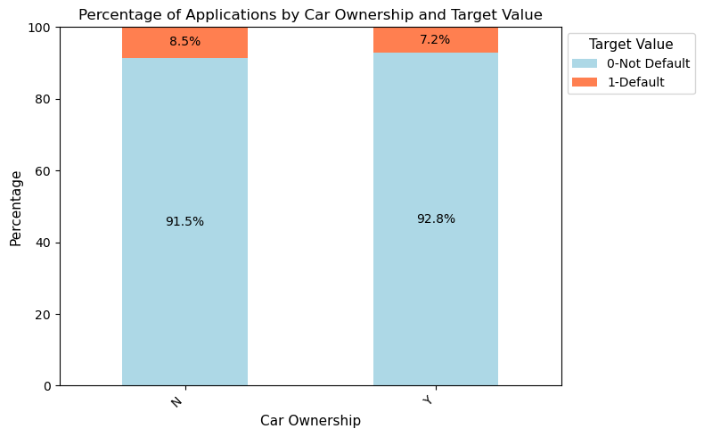
Exploratory Data Analysis
Analyzing the Car Ownership
Insight :
The "No Car" group has 202,924 applications (about 66% of total), while the "Own Car" group has 104,587 applications (around 34%).
The default rate for non-car owners is 8.5%, compared to 7.2% for car owners, indicating that car owners may have greater financial stability and reliability in loan repayment.
Image source: icons8`

Slide 33
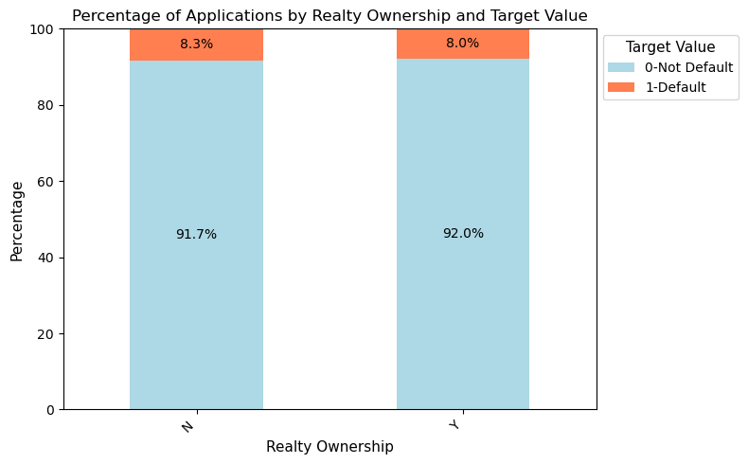
Exploratory Data Analysis
Analyzing the Reality Ownership
Insight :
The Own Realty group has 213,312 applications (69%), indicating financial stability, while the No Realty group has 94,199 applications (31%), suggesting less financial establishment.
The default rate is 8.3% for non-realty applicants and 7.9% for realty owners, showing that owning realty correlates with lower financial risk.
Image source: icons8`

Slide 34
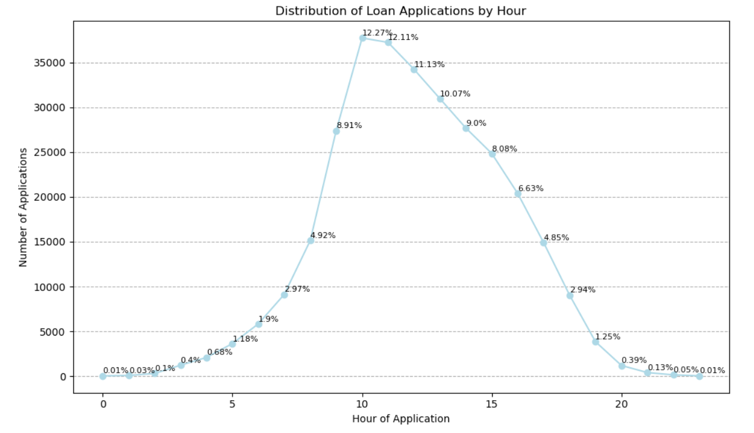
Exploratory Data Analysis
Insight :
Application volume exhibits a clear peak between 10 AM and 1 PM, with the highest activity at 10 AM (37,722 applications, 12.27%) and 11 AM (37,229 applications, 12.11%).
Applications begin to rise significantly from 8 AM, reaching 15,127 at that hour (4.92%), indicating a preference for applying early in the day. After the peak around 11 AM, application numbers gradually decline.
Afternoon activity remains steady but decreases further into the evening, with only 1,196 applications at 8 PM (0.39%) and just 41 at 11 PM (0.01%).
Analyzing the loan applications by the hour of the day
Image source: icons8`

Slide 35
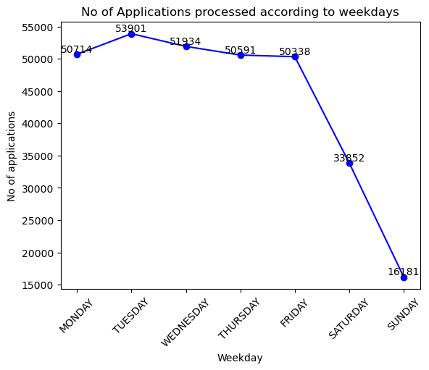
Exploratory Data Analysis
Analyzing the loan applications by the weekday
Insight :
Tuesday is the peak day for loan applications, with 53,901 submissions (17.53%), indicating that borrowers are most active early in the week, Midweek shows steady application counts, with Wednesday at 51,934 (16.89%) and Thursday at 50,591 (16.45%), suggesting that individuals are actively assessing their financial situations.
However, application volume drops over the weekend, with Saturday at 33,852 (11.01%) and Sunday at just 16,181 (5.26%), indicating that potential borrowers are less engaged with financial decisions during this time.
Image source: icons8`

Slide 36
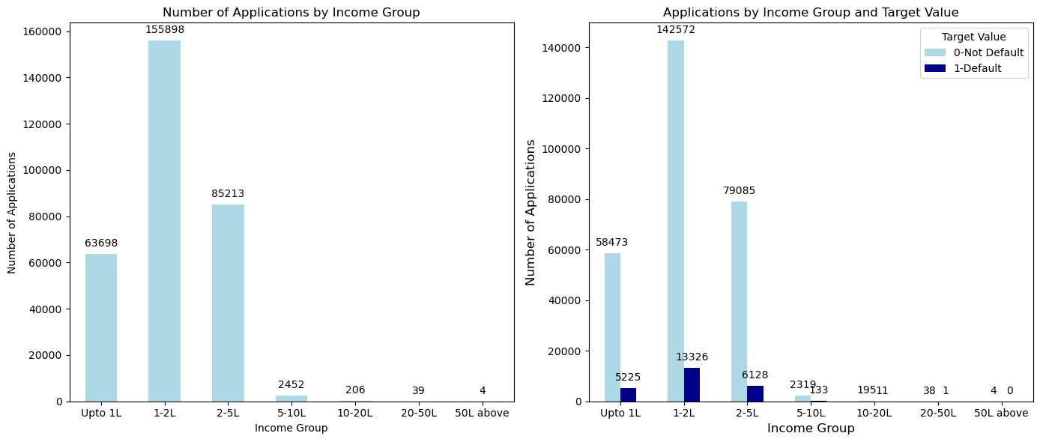
Exploratory Data Analysis
Analyzing the Income group
Insight :
The data shows notable trends across income brackets. The "Upto 1 lakh" group has 63,698 applications (17.3% of total), highlighting engagement from lower-income individuals. The "1-2 lakh" group leads with 155,898 applications (42.5%), suggesting strong activity for major purchases or investments. Engagement drops sharply in higher brackets, with just 0.7% (2,452) from the "5-10 lakh" range and even fewer in "10-20 lakh" (206), "20-50 lakh" (39), and "50 lakh and above" (4) categories. This suggests most loan applicants fall within the lower to middle-income ranges.
Image source: icons8`

Slide 37
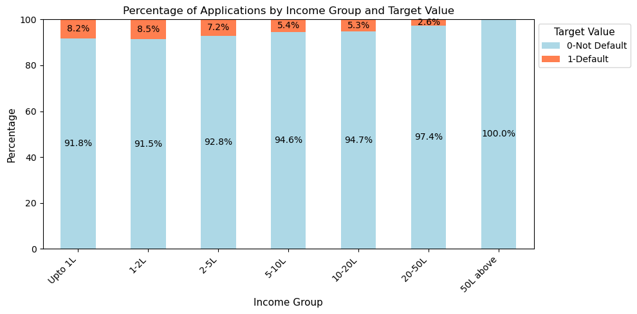
Exploratory Data Analysis
Insight:
The "Upto 1 lakh" group has 63,698 applications (17.3%), while "1-2 lakh" borrowers account for 155,898 (42.5%), indicating strong engagement from lower to middle-income applicants.
Higher income brackets show limited interest, with only 0.7% (2,452) from the "5-10 lakh" group.
Default rates are higher in the lower-income groups, at 8.2% for "Upto 1 lakh" and 8.5% for "1-2 lakh," decreasing to 7.2% for "2-5 lakh" and 5.4% for "5-10 lakh," reflecting greater repayment reliability among higher-income borrowers.
Analyzing the Income group
Image source: icons8`

Slide 38
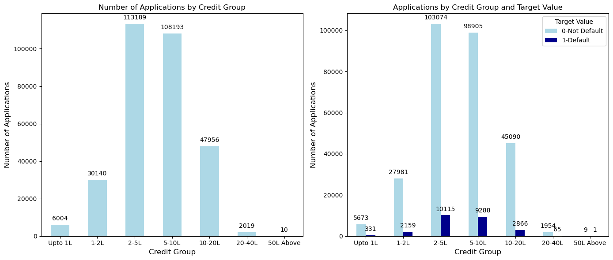
Exploratory Data Analysis
Analyzing the Credit group
Insight :
The 2-5 lakh credit group has the highest application volume, suggesting a significant demand for loans within this bracket, likely for major purchases or investments.
Image source: icons8`

Slide 39
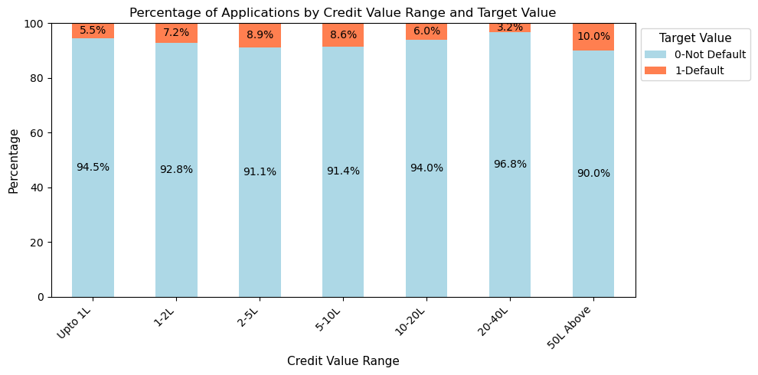
Exploratory Data Analysis
Analyzing the Credit group
Insight :
Default rates rise with credit amounts, peaking at 8.9% for 2-5 lakh and falling to 3.2% for 20-40 lakh.
Very high credit groups (20 lakh and above) attract fewer applicants, suggesting a preference for smaller loans or alternative financing.
Image source: icons8`

Slide 40
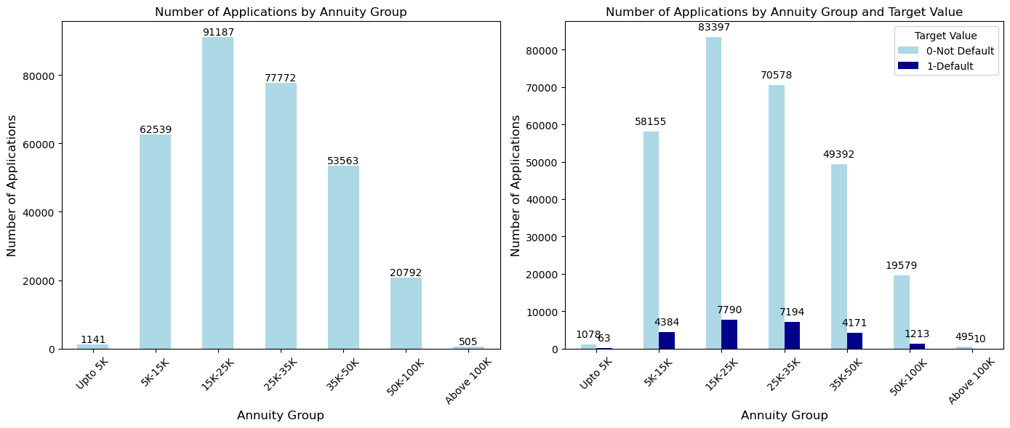
Exploratory Data Analysis
Analyzing the Annuity group
Insight :
The 15K-25K annuity group is the most popular, with 91,187 applications (approximately 30.7% of all applications), indicating strong demand for loans in this monthly payment range. The 5K-15K group also attracts significant interest, with 62,539 applications (about 21.3%).
Image source: icons8`

Slide 41
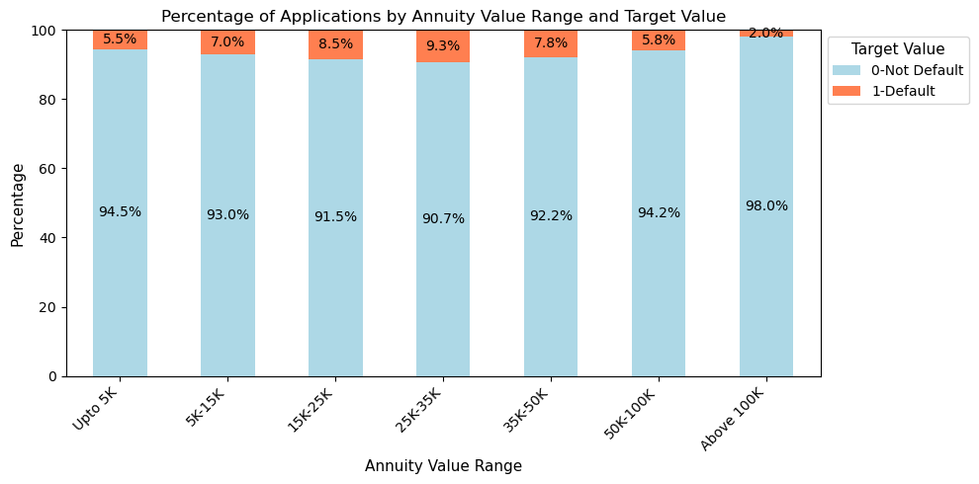
Exploratory Data Analysis
Analyzing the Annuity group
Insight :
The 25K-35Kgroup has 77,772 applications (26.5%), while interest drops to 505 applications (0.2%) for Above 100K
Default rates increase with payment amounts: 5.5% (Up to 5K), 7.0% (5K-15K), 8.4% (15K-25K), and 9.3% (25K-35K).
The 50K-100K group has a lower default rate of 5.8%, indicating greater financial stability.
Image source: icons8`

Slide 42
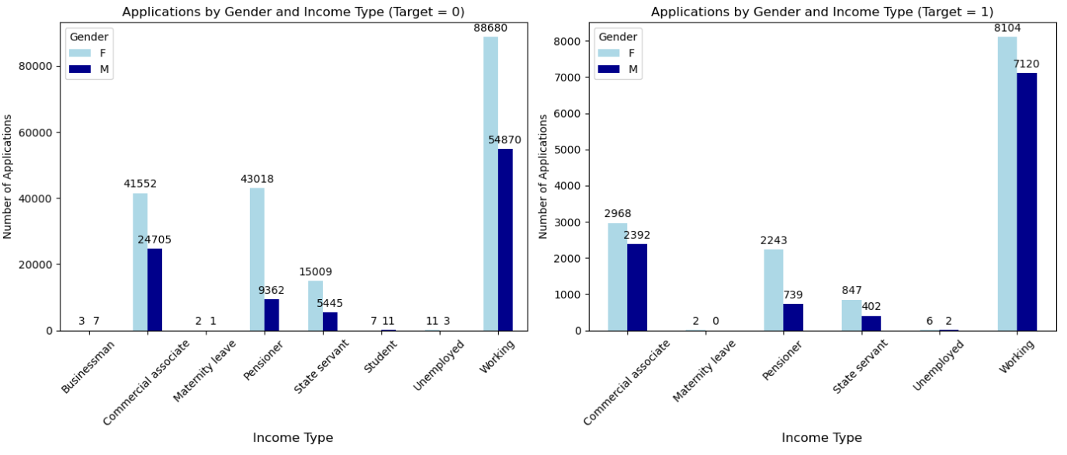
Exploratory Data Analysis
Analyzing the Income type by gender
Insight :
Both genders face challenges, but men show higher defaults in the Working category, while low defaults among Pensioners suggest that retired individuals are generally better positioned to manage their financial obligations.
Image source: icons8`

Slide 43
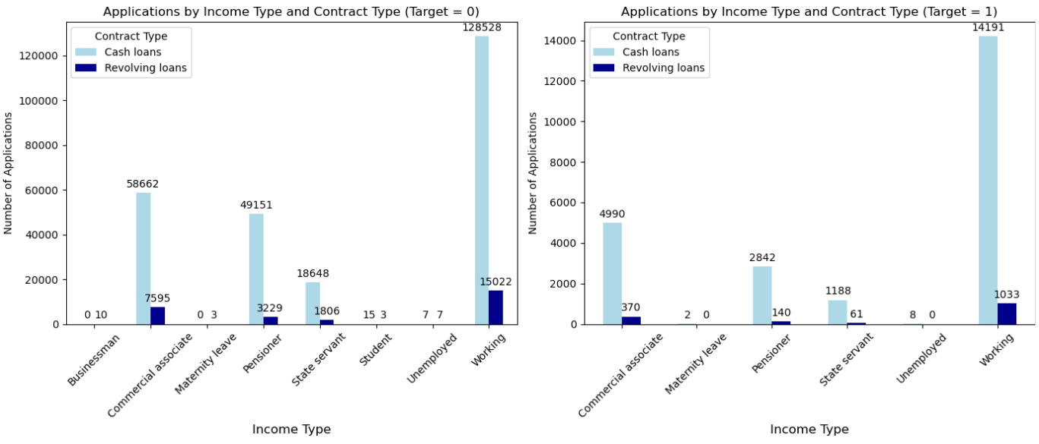
Exploratory Data Analysis
Analyzing the Contract type and income type as per target
Insight :
The "Working" category has for approximately 70% of total non-defaulter applications, while the "Commercial associate" contributes about 25% of these applications. Among defaulters, both the "Commercial associate" and "Working" categories represent roughly 20% of their total applications, highlighting a higher risk associated with these income types.
Image source: icons8`

Slide 44
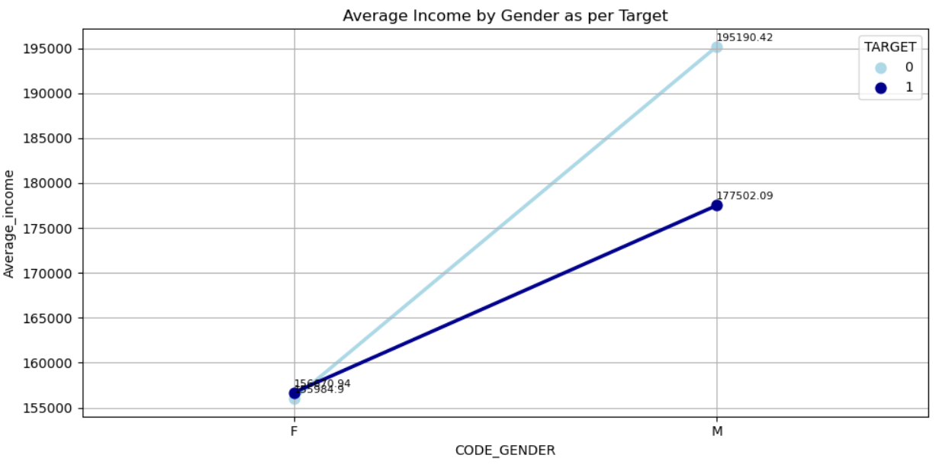
Exploratory Data Analysis
Average Income type by gender according to Target
Insight :
Overall, males have a higher average income than females in both target categories, indicating a gender income gap.
While female incomes are closer in range between defaulters and non-defaulters, male incomes show a more significant disparity, suggesting that income stability could be more critical for male borrowers in avoiding defaults.
Image source: icons8`

Slide 45
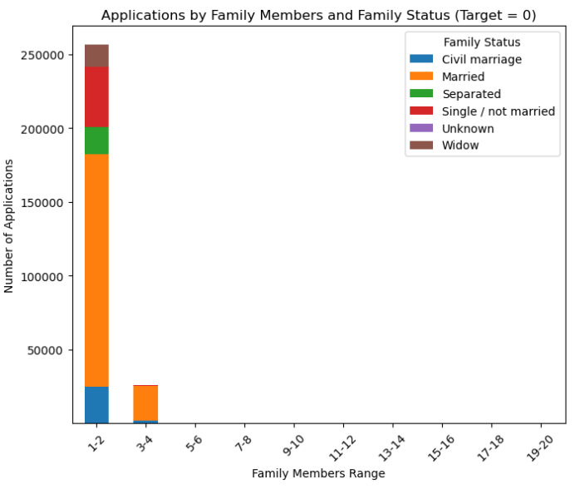
Exploratory Data Analysis
Analyzing family member and family status
Insight :
1-2 Member Families: Majority of non-defaulters, suggesting smaller units manage finances better.
Married Applicants: 157,646 applications, indicating strong repayment rates among married individuals.
Single/Unmarried Applicants: 40,904 applications, also showing high repayment capability.
3-4 Member Families: 23,517 applications from married couples; repayment rates still significant.
5+ Member Families: Sharp decline in applications, suggesting larger families face more financial challenges.
Image source: icons8`

Slide 46
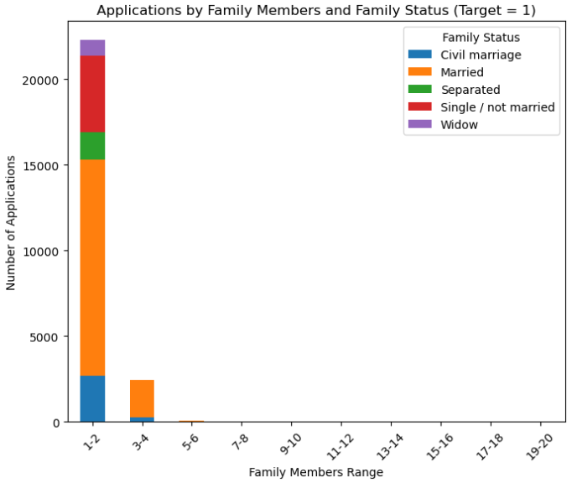
Exploratory Data Analysis
Analyzing family member and family status
Insight :
In the default category, the trend reveals that smaller families still have the highest number of defaults, with 12,625 defaulters among married individuals and 4,442 defaulters for singles. This indicates that even though smaller family units may generally be more financially stable, they can still encounter significant financial difficulties leading to defaults.
In contrast, larger families show relatively low default rates, suggesting that having more family members can provide a buffer against financial hardships.
Image source: icons8`

Slide 47
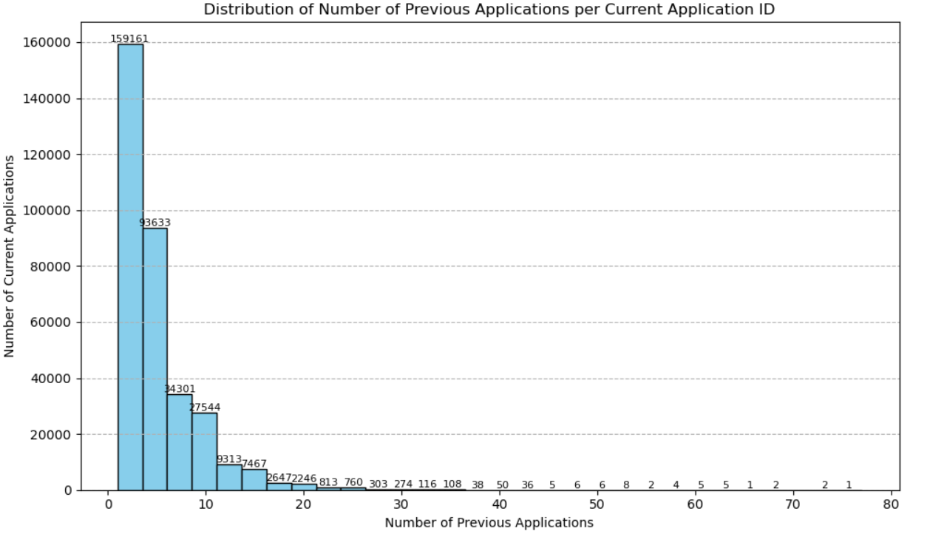
Exploratory Data Analysis
Relationship between current application and previous application IDs
Insight :
Maximum number of current applications have around 0 to 10 previous applications.
The number keeps on decreasing with the greater number of previous applications.
only three customer had previous applications greater than 70
Image source: icons8`

Slide 48
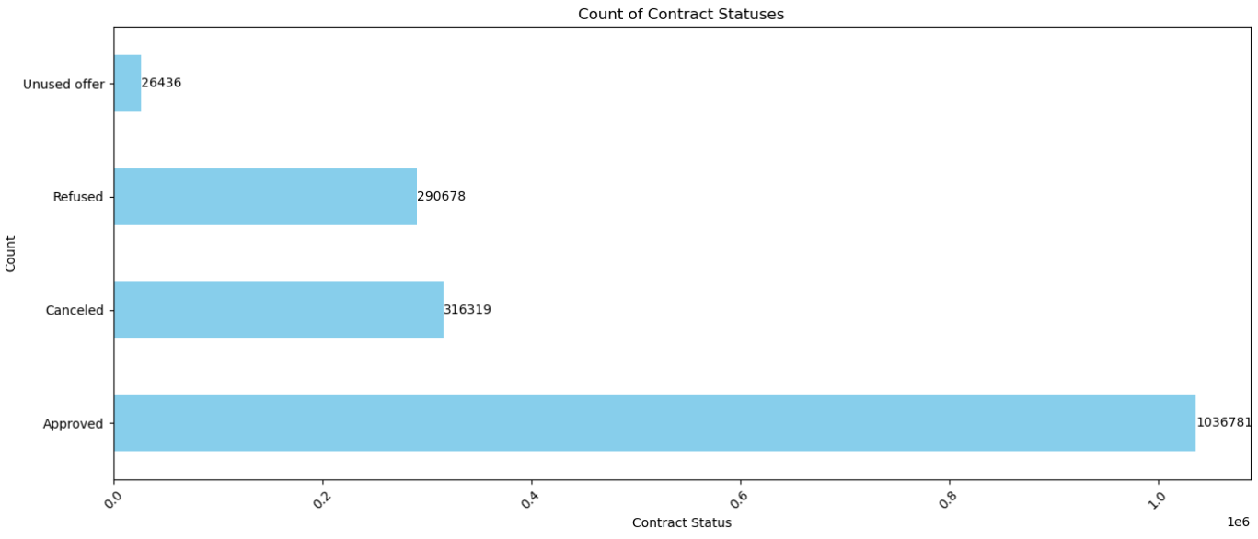
Exploratory Data Analysis
Analyzing the Contract Status
Insight :
The contract status data reveals a strong approval rate, with over 1 million contracts approved, indicating an effective acceptance process.
However, the significant numbers of cancellations (316,319) and refusals (290,678)—together accounting for about 37% of total contracts—highlight potential issues in negotiations or applications that warrant investigation.
The relatively low count of unused offers (26,436) suggests effective follow-up, yet it also raises the possibility of missed opportunities for conversion.
Image source: icons8`

Slide 49
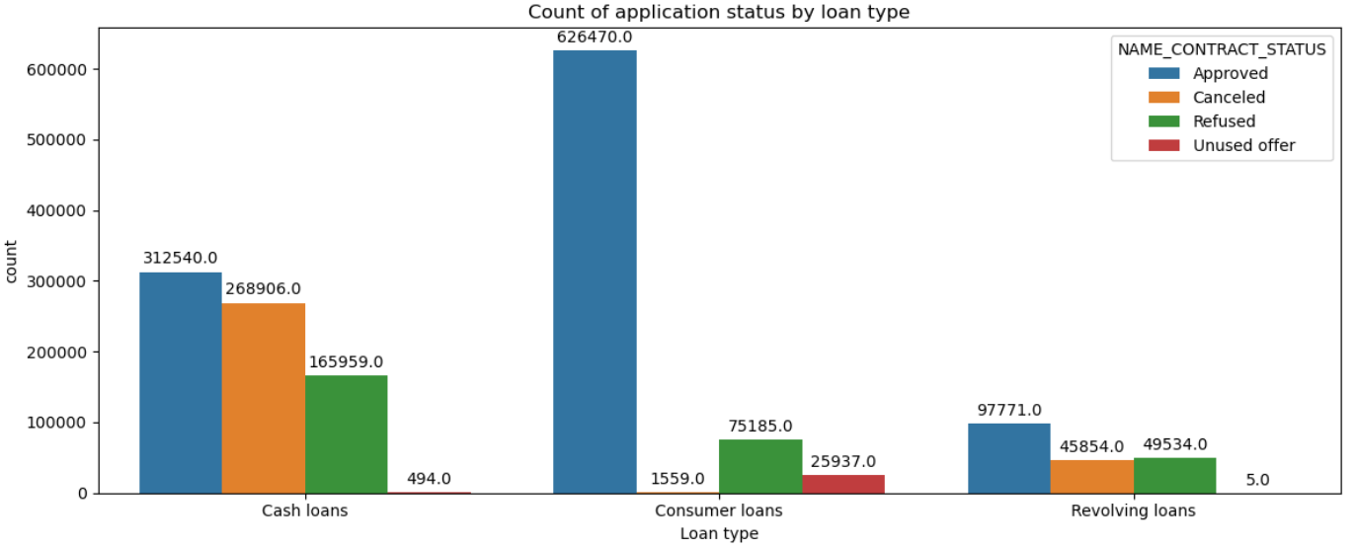
Exploratory Data Analysis
Analyzing the number of applications by Loan Type
Image source: icons8`

Slide 50
Exploratory Data Analysis
Analyzing the number of applications by Loan Type
Insight :
Consumer loans have the highest approval count at 626,470, indicating strong demand and acceptance.
In contrast, cash loans show a high cancellation rate (268,906) and a notable refusal count (165,959), suggesting potential challenges in this category.
Revolving loans, while having the lowest approval count (97,771), also exhibit a significant number of refusals (49,534) and cancellations (45,854).
The low counts of unused offers across all loan types indicate effective follow-up, but the discrepancies in approval and refusal rates suggest targeted improvements may be needed, particularly for cash and revolving loans, to enhance overall conversion rates.
Image source: icons8`

Slide 51
Exploratory Data Analysis
Analyzing the Purpose and the contract status
NAME_CONTRACT_STATUS /NAME_CASH_LOAN_PURPOSE | Car repairs | Education | Everyday expenses | Money for a third person | Other | Payments on other loans | Purchase of electronic equipment
Approved | 358 | 765 | 1236 | 12 | 6677 | 304 | 588
Canceled | 17 | 21 | 13 | 0 | 314 | 70 | 8
Refused | 422 | 782 | 1147 | 13 | 8519 | 1553 | 461
Unused offer | 0 | 5 | 20 | 0 | 98 | 4 | 4
Image source: icons8`

Slide 52
Exploratory Data Analysis
Analyzing the Purpose and the contract status
Insight :
Purposes like XAP, purchase of electronics, every day expenses and education have maximum loan acceptance.
Payment of other loans, refusal to name goal (can be suspicious) , buying new home or car have most refusals.
40% of XNA(Not available) purpose loans are cancelled, followed by buying a garage/home/car.
% unused is too low to get any insight.
Image source: icons8`

Slide 53
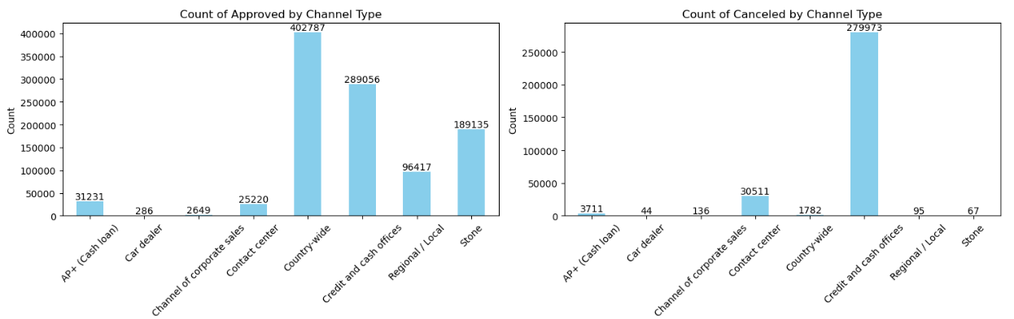
Exploratory Data Analysis
Analyzing Contract Status by Channel Type
Insight :
The "Country-wide" channel has the highest approval count (402,787) and a relatively low cancellation rate (1,782), indicating strong performance in this channel.
The "Contact center" channel has the highest cancellation count (30,511)
Image source: icons8`

Slide 54
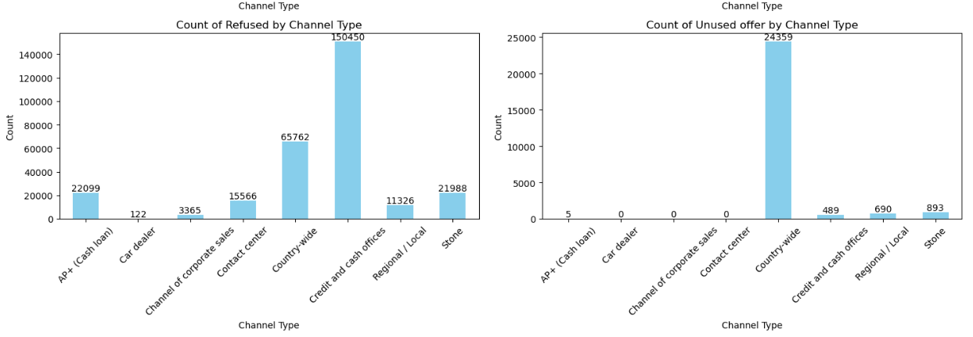
Exploratory Data Analysis
Analyzing Contract Status by Channel Type
Insight :
The "Contact center" channel has a significant number of refusals (15,566), suggesting potential issues in service or communication. The "Regional / Local" and "Stone" channels display moderate performance but still have noteworthy refusal counts.
Image source: icons8`

Slide 55
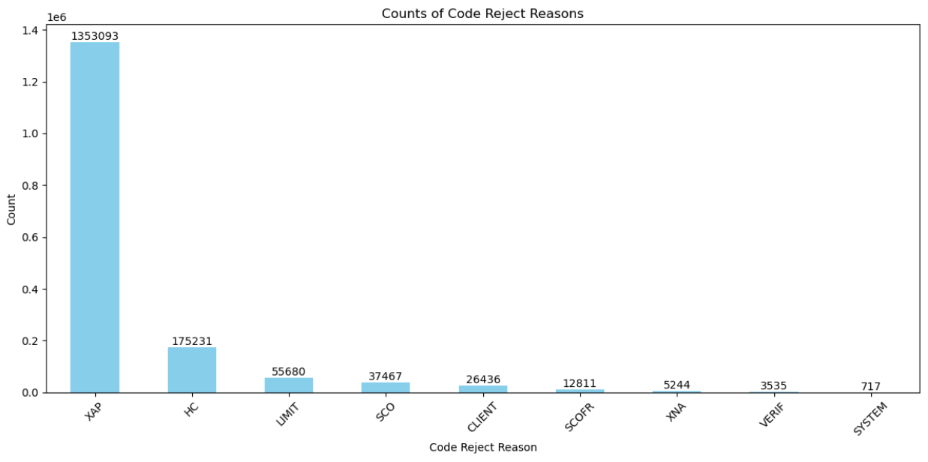
Exploratory Data Analysis
Analyzing Contract Status by Channel Type
Insight :
The rejection reason analysis reveals that "XAP" accounts for a staggering 80.34% of total rejections (1,353,093), highlighting it as a critical issue that requires immediate attention to improve approval rates.
The second most significant reason, "HC," makes up 10.43% (175,231), suggesting another area where systemic problems may exist.
The smaller rejection categories, including "CLIENT" (1.59%), "SCOFR" (0.77%), "XNA" (0.32%), "VERIF" (0.21%), and "SYSTEM" (0.04%), collectively account for a minor portion of total rejections
Image source: icons8`

Slide 56
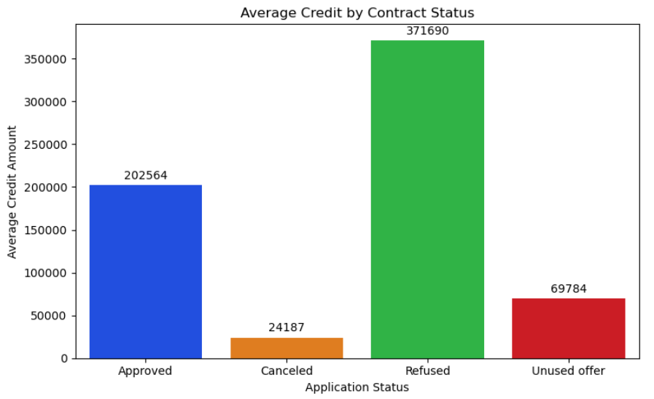
Exploratory Data Analysis
Analyzing Credit by Contract Status
Insight :
Approved Contracts: Average credit amount of 202,564, indicating robust lending for accepted applications.
Canceled Contracts: Significantly lower average of 24,187, suggesting smaller loans may be abandoned.
Refused Contracts: Highest average at 371,690, indicating larger loan requests often get denied.
Lending Criteria: Strict criteria may lead to a mismatch between borrower requests and qualifications.
Unused Offers: Average of 69,784 suggests moderate value, indicating opportunities for improved conversion strategies.
Image source: icons8`

Slide 57
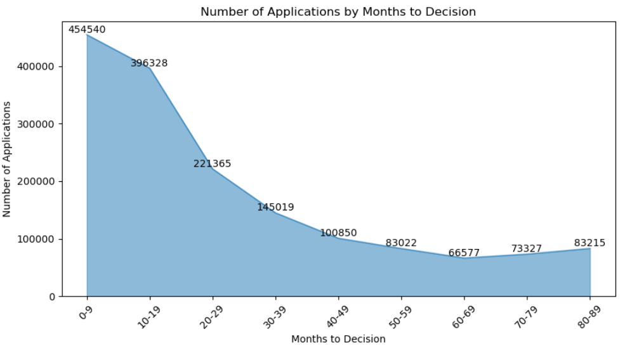
Exploratory Data Analysis
Analyzing Days to Decide and number of applications
Insight :
The graph tells us that most of the people had decided apply for a second application within the first 9 months of applying for the first time.
From the 19th month onwards, there is a significant decline in the number of applications, indicating that with the passage of time, not more borrowers would like to apply for a second loan.
Image source: icons8`

Slide 58
Exploratory Data Analysis
Analyzing Good Category and Contract Status
Insight :
The analysis reveals that "Mobile" (186,174) and "Computers" (88,050) have the highest approval counts, indicating strong demand in technology-related products.
Categories like "Audio/Video" (9,080 refusals) and "Computers" (13,534 refusals) face significant challenges in meeting approval criteria.
"XNA" shows a high cancellation rate (316,107), suggesting potential issues that need addressing.
Image source: icons8`

Slide 59
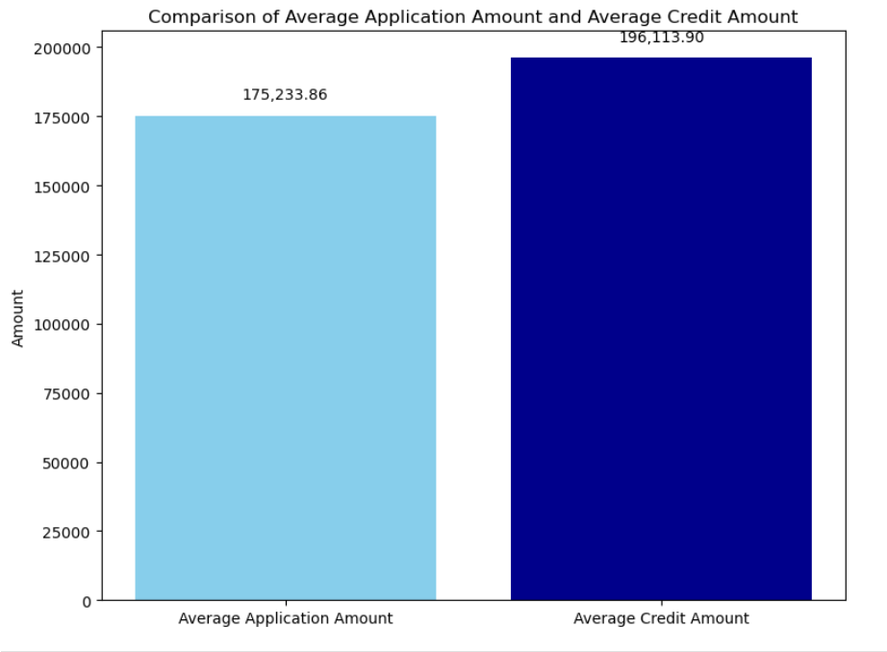
Exploratory Data Analysis
Analyzing the Average Application Amount and Average Credit Amount
Insight :
The average application amount is 175,233.86, while the average credit amount is higher at 196,113.90.
This discrepancy suggests that people are often asking for more money than they apply for, which could show that they feel confident about getting approved or that they need more funding than they originally requested.
Image source: icons8`

Slide 60

Exploratory Data Analysis
Distribution of Interest Rates for Primary and Privileged Clients
Insight:
Lower Interest for Primary Clients (maximum 2%): Reflects more affordable loan options, likely due to lower loan amounts or better risk profiles.
Higher Interest for Privileged Clients (8%+): Indicates larger loan amounts or specialized products with higher risks, which these clients accept for access to more exclusive terms.

Slide 61


Slide 62


Slide 63


Slide 64


Slide 65
STEPS THAT CAN BE TAKEN TO REDUCE DEFAUTERS AND INCREASE INCOME
As a higher percentage of female applicants (7.51% or 14,170 out of 188,282) are non-defaulters compared to males (11.29% or 10,655 out of 94,404), banks can develop targeted marketing strategies specifically for female customers to enhance their loyalty.
Banks should focus on targeted marketing strategies aimed at the "Working" demographic, which shows high application rates and lower default risk.
The bank can require documentation of stable income from borrowers to verify their ability to afford the loan, thus helping to minimize the risk of defaults.
By offering financial education and tailored support for vulnerable groups, individuals, can help reduce default rates and also maintain the customer loyality.
Foster stronger relationships with customers by offering tailored products and services, encouraging them to seek help before defaulting.
Enhance risk assessment models to better identify potential defaulters before they miss payments, allowing for early intervention.
Bank can offer incentives for timely payments, such as interest rate reductions or discounts on future loans, to encourage responsible borrowing behavior.

Slide 66

Predictive Modeling for Risk Management in BFSI
An Overview of Predictive Models and their Performance

Slide 67

Objective of the Analysis
Data Preprocessing and Feature Engineering
Model Development
Model Evaluation and Performance
Insights and Conclusions
Agenda

Slide 68

Purpose of the Analysis
To develop predictive models that accurately identify defaulters and non-defaulters in the dataset.
Key Focus
Leverage machine learning techniques to improve the accuracy and reliability of predictions.
Understand the most significant features influencing the prediction of defaulters.
Goal
Build a range of models to compare performance, identify strengths, and determine the most effective approach for predicting loan defaults.
Objective​

Slide 69

Data Preprocessing:
Feature Engineering:
Dimensionality Reduction:
Handling Imbalanced Data:
Algorithm Selection:
Models including Random Forest and Logistic Regression were chosen for their robustness, interpretability, and ability to handle high-dimensional data effectively.
Techniques like down-sampling and the application of class weights were considered to balance the dataset for fair model training.
PCA was used to reduce the feature space, improving computation speed while retaining significant variance in the data.
Domain knowledge and correlation analysis were applied to select the most relevant features, enhancing model accuracy.
The data was cleaned, missing values were handled, and outliers were treated to ensure a high-quality dataset.
Model Building Process

Slide 70
Data Preparation
Data Cleaning
Removed columns with more than 40% missing values to improve data quality and model performance.
Converted categorical features into numerical codes for compatibility with machine learning algorithms.
Feature Scaling
Standardized features using StandardScaler to ensure each feature contributes equally to the model.
Null Value Treatment
Imputed or removed rows with missing values to ensure the completeness and reliability of the dataset.
Outlier Treatment
Identified and handled outliers to reduce their impact on model accuracy and predictions.
Categorical Encoding

Slide 71
Commonly Used Algorithms for Classification
Logistic Regression
Advantages:
Simple and easy to implement.
Interpretable results with coefficients indicating feature impact.
Effective for binary classification problems.
Disadvantages:
Assumes a linear relationship between features and the target variable.
Struggles with complex relationships and high-dimensional data.
Decision Trees
Advantages:
Easy to interpret and visualize.
Handles both numerical and categorical data.
Requires little data preprocessing.
Disadvantages:
Prone to overfitting, especially with deep trees.
Sensitive to small changes in data, leading to different splits.
Random Forest
Advantages:
Reduces overfitting by averaging multiple trees.
Handles high-dimensional data well.
Provides feature importance metrics.
Disadvantages:
Less interpretable compared to single decision trees.
Can be computationally intensive with large datasets.
Support Vector Machines (SVM)
Advantages:
Effective in high-dimensional spaces.
Works well for both linear and non-linear classification using kernel functions.
Disadvantages:
Sensitive to the choice of kernel and regularization parameters.
Computationally expensive for large datasets.
K-Nearest Neighbors (KNN)
Advantages:
Simple and intuitive, easy to implement.
Non-parametric, making no assumptions about data distribution.
Disadvantages:
Computationally expensive during prediction, especially with large datasets.
Sensitive to irrelevant features and the scale of data.
Naive Bayes
Advantages:
Fast and efficient for large datasets.
Performs well with categorical features and in text classification.
Disadvantages:
Assumes independence among features, which may not hold in practice.
Less effective with small datasets.

Slide 72

Model 1: Random Forest Classifier (Initial Model)
Trained using all features to establish a baseline performance.
Model 2: Random Forest Classifier +Domain Knowledge
Reduced feature set chosen based on domain expertise for improved efficiency.
Model 3: Random Forest +Correlated features
Focused on the most correlated features to target variable for optimized predictions.
Model 4: Random Forest with Grid Search Optimization
Hyperparameters tuned using Grid Search to enhance model performance.
Model 5: Random Forest + PCA
Dimensionality reduced via PCA to boost model speed and reduce complexity.
Model 6: Logistic Regression + PCA
Implemented a simplified model with PCA for better interpretability and classification performance.
Predictive Models Overview

Slide 73


Accuracy:
Definition: The percentage of total predictions that were correct.
Example: If a model predicts 90 out of 100 applicants correctly (whether they will default or not), the accuracy is 90%.
Precision:
Definition: The proportion of true positive predictions among all positive predictions (i.e., correctly identified defaulters).
Example: If the model predicts 40 applicants as defaulters, but only 30 actually defaulted, precision is 75% (30/40).
Recall (Sensitivity):
Definition: The proportion of true positive predictions among all actual positives (i.e., all actual defaulters).
Example: If there are 50 actual defaulters and the model correctly identifies 30 of them, recall is 60% (30/50).
F1 Score:
Definition: The harmonic mean of precision and recall, providing a balance between the two metrics.
Example: For a precision of 75% and recall of 60%, the F1 Score is about 66.67%.
Support:
Definition: The number of actual occurrences of the positive class (i.e., actual defaulters) in the dataset.
Example: If there are 100 actual defaulters in the dataset, the support for this class is 100.
Model Evaluation Metrics

Slide 74
Model Evaluation Comparison Summary
Model | Features Used | Technique | Accuracy Score | Precision (Class 0) | Precision (Class 1) | Recall (Class 0) | Recall (Class 1)
Model 1 | All features | Random Forest | 68.24% | 0.68 | 0.69 | 0.74 | 0.62
Model 2 | Domain Knowledge Features | Random Forest | 61.34% | 0.61 | 0.62 | 0.69 | 0.53
Model 3 | Top Correlated Features | Random Forest | 60.77% | 0.61 | 0.61 | 0.69 | 0.52
Model 4 | All Features | Random Forest (Grid Search) | 68.24% | 0.68 | 0.69 | 0.74 | 0.62
Model 5 | PCA Components (27 components) | Random Forest + PCA | 67.45% | 0.67 | 0.68 | 0.73 | 0.61
Model 6 | PCA Components (27 components) | Logistic Regression + PCA | 68.51% | 0.68 | 0.69 | 0.73 | 0.64
Simplicity: Logistic Regression with PCA offers a simpler interpretation due to the reduced number of dimensions, while still capturing 95% of the variance in the data.
Best Model: Model 6
Higher Accuracy: Model 6 achieved the highest accuracy (68.51%), indicating it provides the best generalization for this classification task.
Improved Recall for Class 1 (Defaulters): Model 6 has better recall for the defaulter class (64%), which is crucial in risk or default detection models, where it is essential to identify defaulters accurately.

Slide 75



Mathematical Equation of the Logistic Model:​

Slide 76
Mathematical Equation of the Logistic Model:​
Logit(p) = (-0.100)*NAME_CONTRACT_TYPE + (0.207)*CODE_GENDER + (-0.133)*FLAG_OWN_CAR + (0.022)*FLAG_OWN_REALTY + (-0.007)*CNT_CHILDREN + (-0.057)*AMT_INCOME_TOTAL + (-0.037)*AMT_CREDIT + (0.073)*AMT_ANNUITY + (-0.008)*NAME_TYPE_SUITE + (0.034)*NAME_INCOME_TYPE + (0.187)*NAME_EDUCATION_TYPE + (0.026)*NAME_FAMILY_STATUS + (0.026)*NAME_HOUSING_TYPE + (0.022)*REGION_POPULATION_RELATIVE + (-0.016)*DAYS_BIRTH + (-0.184)*DAYS_EMPLOYED + (-0.016)*DAYS_REGISTRATION + (-0.037)*DAYS_ID_PUBLISH + (0.000)*FLAG_MOBIL + (0.000)*FLAG_WORK_PHONE + (0.007)*FLAG_CONT_MOBILE + (-0.026)*FLAG_PHONE + (0.000)*FLAG_EMAIL + (0.066)*REGION_RATING_CLIENT + (0.015)*WEEKDAY_APPR_PROCESS_START + (-0.022)*HOUR_APPR_PROCESS_START + (0.000)*REG_REGION_NOT_LIVE_REGION + (0.000)*REG_REGION_NOT_WORK_REGION + (0.000)*REG_CITY_NOT_LIVE_CITY + (0.018)*REG_CITY_NOT_WORK_CITY + (0.031)*ORGANIZATION_TYPE + (-0.426)*EXT_SOURCE_2 + (-0.610)*EXT_SOURCE_3 + (0.019)*OBS_30_CNT_SOCIAL_CIRCLE + (0.000)*DEF_30_CNT_SOCIAL_CIRCLE + (-0.063)*DAYS_LAST_PHONE_CHANGE + (0.000)*FLAG_DOCUMENT_2 + (0.054)*FLAG_DOCUMENT_3 + (0.000)*FLAG_DOCUMENT_4 + (0.000)*FLAG_DOCUMENT_5 + (0.000)*FLAG_DOCUMENT_6 + (0.000)*FLAG_DOCUMENT_7 + (0.000)*FLAG_DOCUMENT_8 + (0.000)*FLAG_DOCUMENT_9 + (0.000)*FLAG_DOCUMENT_10 + (0.000)*FLAG_DOCUMENT_11 + (0.000)*FLAG_DOCUMENT_12 + (0.000)*FLAG_DOCUMENT_13 + (0.000)*FLAG_DOCUMENT_14 + (0.000)*FLAG_DOCUMENT_15 + (0.000)*FLAG_DOCUMENT_16 + (0.000)*FLAG_DOCUMENT_17 + (0.000)*FLAG_DOCUMENT_18 + (0.000)*FLAG_DOCUMENT_19 + (0.000)*FLAG_DOCUMENT_20 + (0.000)*FLAG_DOCUMENT_21 + (0.000)*AMT_REQ_CREDIT_BUREAU_HOUR + (0.000)*AMT_REQ_CREDIT_BUREAU_DAY + (0.000)*AMT_REQ_CREDIT_BUREAU_WEEK + (0.000)*AMT_REQ_CREDIT_BUREAU_MON + (0.000)*AMT_REQ_CREDIT_BUREAU_QRT + (0.028)*AMT_REQ_CREDIT_BUREAU_YEAR + (-0.096) ​

Slide 77

Top Positive Influences:
Higher values in these features increase the predicted likelihood of default.
CODE_GENDER (0.207):
AMT_ANNUITY (0.073):
REGION_RATING_CLIENT (0.066):
FLAG_DOCUMENT_3 (0.054):
NAME_INCOME_TYPE (0.034):
ORGANIZATION_TYPE (0.031):
AMT_REQ_CREDIT_BUREAU_YEAR (0.028):
NAME_FAMILY_STATUS (0.026):
NAME_HOUSING_TYPE (0.026):
Specific gender codes increase the likelihood of default
Higher education levels are linked to higher default risk, possibly due to related debt or career types.
Higher loan payments suggest a greater risk of default as debt burden increases.
Higher regional ratings imply areas where clients are more prone to default, perhaps due to economic factors.
Specific document flags may indicate higher risk profiles.
Specific housing types may link to higher default rates due to differences in asset stability.
Certain marital statuses may correlate with higher risk, reflecting diverse financial behaviors.
More annual credit inquiries suggest potential financial stress, increasing default probability.
Employment in particular sectors may relate to higher default risk, likely from job instability.
Certain income types, like self-employment, show higher default risk due to less predictable income.
NAME_EDUCATION_TYPE (0.187):

Slide 78

Top Negative Influences:
In these cases, higher values generally indicate financial stability, resulting in a lower likelihood of default.
EXT_SOURCE_3 (-0.610):
EXT_SOURCE_2 (-0.426):
DAYS_EMPLOYED (-0.184):
FLAG_OWN_CAR (-0.133):
NAME_CONTRACT_TYPE (-0.100):
DAYS_LAST_PHONE_CHANGE (-0.063):
AMT_INCOME_TOTAL (-0.057):
AMT_CREDIT (-0.037):
DAYS_ID_PUBLISH (-0.037):
FLAG_PHONE (-0.026):
Higher scores from external sources are linked to lower default risk, suggesting good financial standing.
Higher external credit scores indicate stability, reducing default probability.
Longer employment duration is associated with decreased default risk, as stable employment often signals reliable income.
Car ownership may reflect financial stability, reducing the chance of default.
Certain contract types are less risky, possibly reflecting more secure financial agreements.
Recent phone changes may indicate instability; less frequent changes are associated with lower default rates.
Higher income correlates with a lower likelihood of default, showing greater ability to manage financial obligations.
Higher total credit amounts may correlate with reduced risk, possibly due to effective credit management.
The stability in ID-related documents suggests a lower risk of default.
Consistent phone records might indicate financial stability and responsibility.

Slide 79
Thank you!

